Slide 1

Ensemble Learning

Slide 2
Introduction to ensemble learning
Ensemble learning helps improve machine learning results by combining several models.
We can use these techniques for regression as well as classification problems.
The final prediction from these ensembling techniques is obtained by combining results from several base models.
Averaging, voting and stacking are some of the ways the results are combined to obtain a final prediction

Slide 3
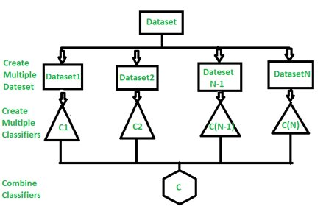

Slide 4

Types of Ensemble Learning
Bagging
Boosting

Slide 5
Bagging
Bagging techniques help avoid the overfitting of the model.
Also known as bootstrap aggregating
subsets of data are taken from the initial dataset.
The subsets are called bootstrapped datasets or, simply, bootstraps
trains multiple models independently on random subsets of the data
The predictions are aggregated through voting or averaging.
So called aggregating

Slide 6
Implementation Steps of Bagging
Step 1: Multiple subsets are made from the original information set with identical tuples, deciding on observations with replacement.
Step 2: A base model is created on all subsets.
Step 3: Every version is found in parallel with each training set and unbiased.
Step 4: The very last predictions are determined by combining the forecasts from all models.

Slide 7
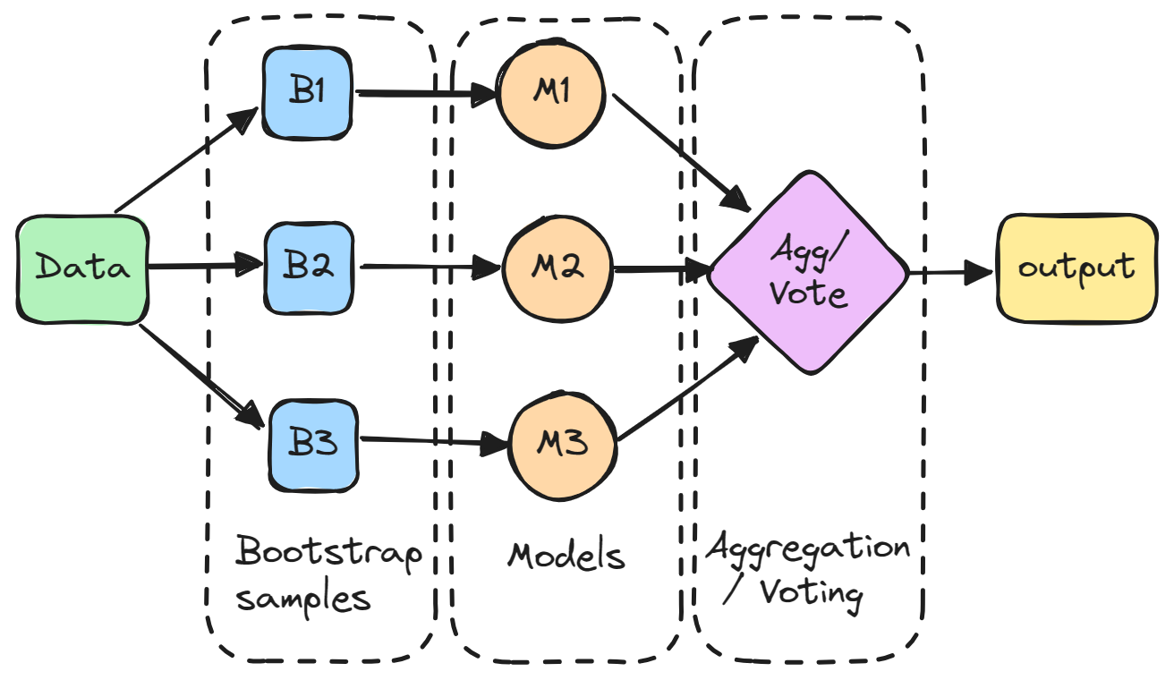

Slide 8
Benefits of Bagging
Reduce Overfitting
Improve Accuracy
Handles Unstable Models

Slide 9
Increased Complexity and Computational Cost
Each model needs to be trained and stored, which can be computationally expensive

Slide 10
Boosting
Boosting is an ensemble modeling technique that attempts to build a strong classifier from the number of weak classifiers.
The main idea behind boosting is to iteratively train weak models on different subsets of the training data
It is done by building a model by using weak models in series.
models are designed to focus more on the examples that the previous models struggled to classify correctly

Slide 11
Implementation Steps of Boosting
1. Initialize weights
At the start of the process, each training example is given equal weight.
2. Train a weak learner
The weighted training data is used to train a weak learner.
3. Error calculation:
The error of the weak learner on the training data is computed.

Slide 12
4. Update weights
Weights are updated according to the mistake rate of the training examples.
Misclassified examples are given higher weights, whereas correctly classified examples are given lower weights.
5. Repeat
Steps 2–4 are repeated several times. A new weak learner is trained on the updated weights of the training examples in each cycle.

Slide 13
6. Combine weak learners
The final model is made up of all of the weak learners that were trained in the preceding steps.
The accuracy of each weak learner is weighted, and the final prediction is based on the weighted total of the weak learners.
7. Forecast
The finished model is used to forecast fresh instances’ class labels.

Slide 14
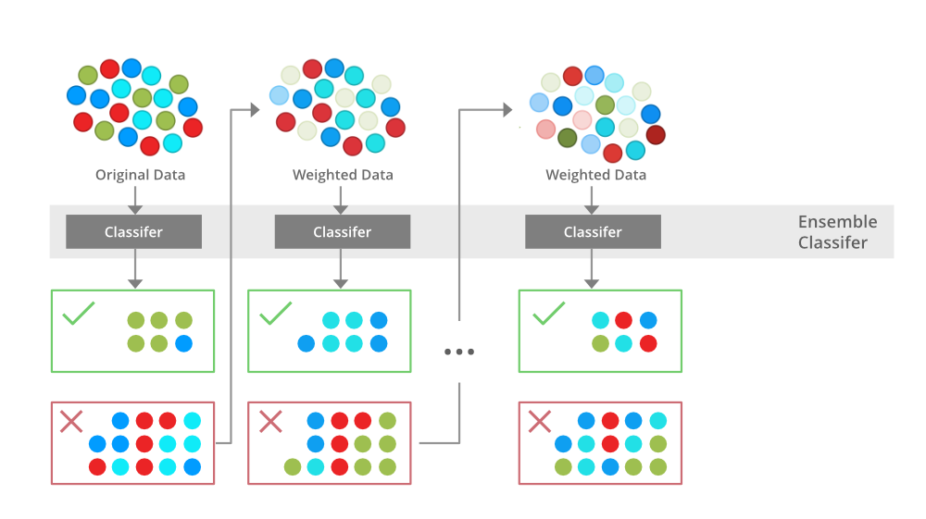

Slide 15
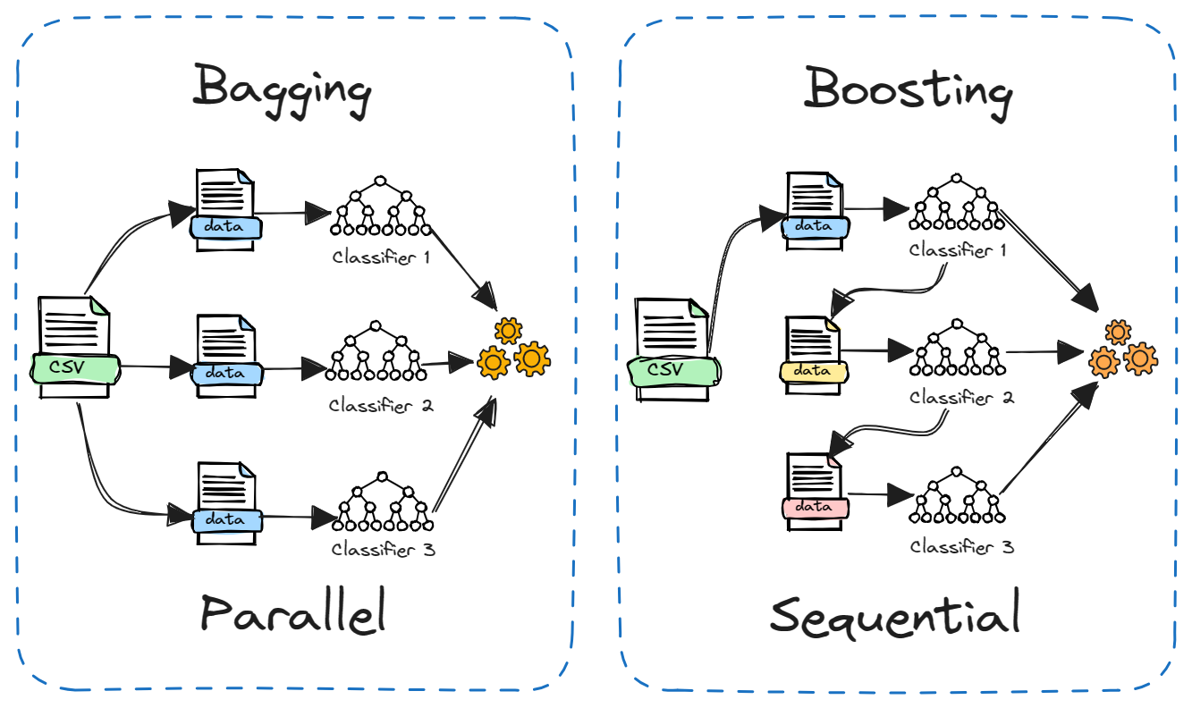

Slide 16
Types Of Boosting Algorithms
Gradient Boosting
XGBoost
Adaboost

Slide 17
Gradient Boosting
popular boosting algorithm
It works by minimizing a loss function, such as mean squared error or log loss, through gradient descent.
In each iteration, the algorithm adds a new decision tree to correct the errors made by the previous trees.
By iteratively updating the model, gradient boosting gradually improves the predictive accuracy.

Slide 18
XGBoost
It is an extended version of Gradient boosting
It uses regularization techniques
It is known for its speed, scalability, and ability to handle large-scale datasets effectively.

Slide 19
AdaBoost
AdaBoost is one of the most extensively used boosting algorithms.
It gives weights to each data point in the training set based on the accuracy of prior models
trains a new model using the updated weights
AdaBoost is very useful for classification tasks.

Slide 20
Advantages of Boosting
Improved Performance
Ability to Handle Complex Data
Robustness to Noise

Slide 21
Disadvantages of Boosting
In some cases, boosting can overfit data, making it hard to extend to new use cases.
The sequential nature of boosting makes it harder to scale or run for real-time analysis.

Slide 22
Thank You

